Slide 1
Optimal defense against election control by deleting voter groups
Yue Yin, Yevgeniy Vorobeychik, Bo An, Noam Hazon
Zachary Mekus and Trevor Larsen

Slide 2
Problem Definition
Election is won by plurality
Control is at voter group level
Voting tallies of groups are known
Defender can allocate resources to a random strategy to defend groups to ensure original winner wins
Attacker knows the defender strategy and can delete voting groups to try to get any other candidate to win

Slide 3
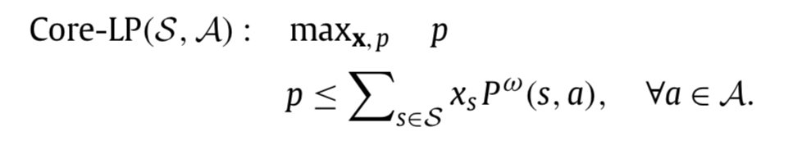
Core-LP

Slide 4
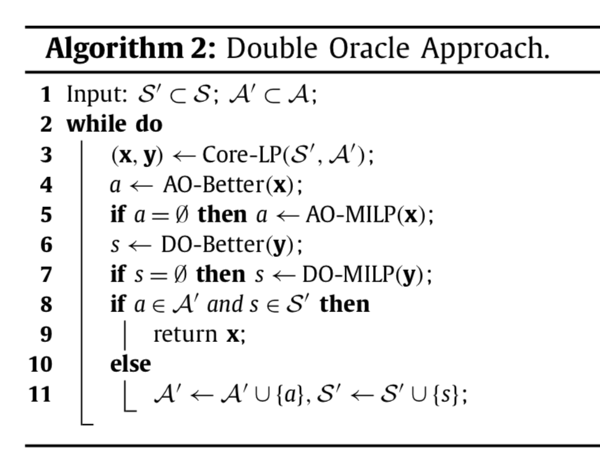

Slide 5
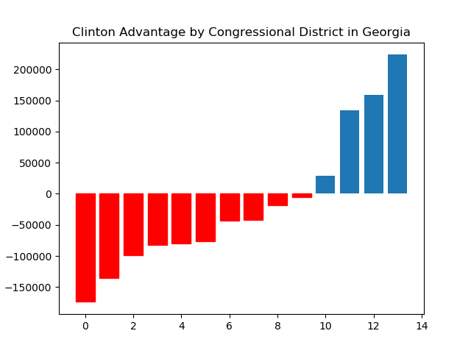
Georgia 2016 Presidential Election Results by Congressional Districts

Slide 6
4 Attacks, 2 Defenses
p=.20
1 1 1 1
.53 .47 .40 .20 .20 .20

Slide 7
5 Attacks, 3 Defenses
p=.29
1 1 1 1 1
.71 .71 .42 .42 .42 .32

Slide 8
7 Attacks, 4 Defenses
p=.25
1 1 1 1 1 1 1
.75 .75 .25 .75 .75 .75

Slide 9
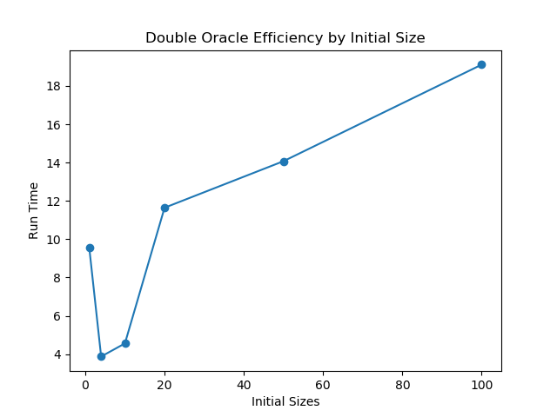
Double Oracle Initial Sizes
Initial attacks: 3432,
Initial defenses: 1001

Slide 10
Timing Differences
Georgia, 7 Attackers, 4 Defenders, Initial Sizes of 4
Core LP | Double Oracle | Double Oracle – No Heuristic
57.80 s | 4.92 s | 6.15 s

Slide 11
Questions?

